Slide 1
DELIVERABLE 1
Deep Learning Architectures for
Multi-Horizon Electricity Load Forecasting

Slide 2
Introduction
Why This Matters
Project Scope
Electricity grids require real-time balance of supply & demand. Forecast errors cause:
• Expensive reserve capacity commitments • Grid instability and outage risk • Excess carbon emissions from peaker plants • Missed renewable integration opportunities
A 1% accuracy improvement saves €1–5M/year per utility.
Dataset
UCI ElectricityLoadDiagrams 2011–2014
370 Portuguese clients, 15-min resolution
Models
LSTM · TCN · Transformer · PatchTST
4 deep learning architectures compared
Horizons
H = 1h, 6h, 24h ahead
(short, intra-day, full-day)
Goal
Identify best architecture for multi-horizon forecasting & LDT pathway

Slide 3
Problem Statement
This project addresses multi-horizon electricity load forecasting using deep learning architectures.
Accurate electricity demand forecasting is critical for:-
Grid Stability
Energy Trading
Infrastructure Planning
Using the UCI ElectricityLoadDiagrams 2011-2014 benchmark dataset (370 Portuguese clients, 15-min resolution). We compare four state-of-the-art architectures — LSTM, TCN, Transformer and PatchTST — across three prediction horizons: 1 hour, 6 hours, and 24 hours ahead.
Our goal is to identify the best architecture for probabilistic load forecasting and establish a pathway toward the Latent Diffusion Transformer (LDT) from AAAI 2024.

Slide 4
Problem & Business Value
FROM — Current State
TO — Target State
Per-client ARIMA / exponential smoothing models
370 separate model training + maintenance pipelines
No cross-client pattern learning
Struggles with DST, holidays & demand shifts
Deterministic point forecasts only — no uncertainty
Single deep learning model across all 370 clients
Shared temporal representations + cross-client patterns
3 forecast horizons: 1h, 6h, 24h simultaneously
Robust preprocessing: DST-aware, Z-score normalized
Probabilistic forecasting path via LDT (D3)
→
VALUE CREATION
💰
Cost Savings
⚡
Grid Stability
🌱
Sustainability
📈
Scalability
1% accuracy gain
= €1–5M/yr saved
Fewer last-minute
reserve dispatches
Lower carbon from
reduced peaker use
One model for
370+ clients

Slide 5
CHANGE MANAGEMENT
Process & Change Management
Area
FROM (Previous)
TO (Next)
Impact
Data Pipeline
Manual CSV download + per-analyst preprocessing scripts
Automated ucimlrepo API fetch with DST-aware hourly resampler
Reproducible, zero-error ingestion
Modeling
370 separate per-client ARIMA/ES models — no knowledge sharing
Single joint deep learning model (LSTM/TCN/Transformer/PatchTST)
Cross-client generalization
Evaluation
In-sample accuracy, risk of data leakage, no holdout period
Strict 70/10/20 chronological split; scaler fitted on train only
Unbiased, leak-free metrics
Deployment
Deterministic point forecasts; uncertainty unknown
Pathway to probabilistic LDT forecasts with CRPS/WIS (D3)
Actionable confidence intervals

Slide 6
Process, Standardization & Automation
01
Ingest & Inspect
02
DST Handling
03
Hourly Resample
ucimlrepo API fetch
140K rows × 370 clients
Zero missing values check
DST gap detection
Detect spring/fall transitions
Spring: zero-fill 01:00–02:00
Fall: accept 2× spike
Dates: last Sunday Mar & Oct
Sum 4 × 15-min = kWh/hr
df.resample('1h').sum()
140,256 → 35,064 rows
Leap year aware (8,784/yr)
→
→
04
Client Filter
05
Normalize & Split
06
Rolling Windows
Filter to 2012+ data only
Drop clients with >5% zeros
370 → ~320 active clients
26,280 hourly records kept
Z-score per client (train only)
Train 70% / Val 10% / Test 20%
Chronological — no leakage
Scaler fit on train set
Lookback L = 168h (1 week)
Horizon H ∈ {1, 6, 24}
Input: (B, 168, N)
Output: (B, H, N)
→
→

Slide 7
Project Milestones and Timeline
D1 (Current): Baseline Models. LSTM, TCN, Transformer, PatchTST on UCI dataset. EDA & preprocessing. Metric framework established.
D3 (Final): LDT Implementation. Statistics-aware autoencoder. Diffusion-based generator. Probabilistic intervals (CRPS/WIS).
Final Benchmark: Complete comparison of all architectures with full probabilistic evaluation.
D1 ✔
D2
D3
Benchmark
Final
D2 (Next): Full-Scale Training. All 320 active clients. Hyperparameter tuning. PatchTST as primary model.
Submission: Final report with conclusions and reproducible code.
Deliverable

Slide 8
Data Description:
Source: UCI Machine Learning Repository – ElectricityLoadDiagrams 2011–2014 (ID: 321) Type: Multi-client electricity consumption time series Resolution: 15-minute readings (resampled to hourly) Clients: 370 total; 320 active clients retained (2012–2014)
Features :
Data Scope & Structure :
Time Features: Hour, Day-of-Week, Month, Year
Lag Features: 24-hour and 168-hour lags
Lookback Window: 168 hours (1 week)
Forecast Horizons: H ∈ {1, 6, 24} hours ahead
Normalization: Z-score (per client, train-only
Time Period Used: January 2012 – December 2014
(36 months)
Frequency: Hourly (aggregated from 15-min intervals)
Total Records: ~35,064 hourly timestamps × 320 clients
Split Strategy: Chronological Train / Validation / Test
7 / 18

Slide 9
Dataset: UCI ElectricityLoadDiagrams 2011–2014
370
140K+
4 Years
0
Clients
(320 active
2012–2014)
Timestamps
(15-min
granularity)
Jan 2011 –
Dec 2014
Missing
Values
Preprocessing Pipeline
15-min
→ Hourly
Remove 2011
(sparse start)
Z-score
Normalization
Train/Val/Test
70/10/20%
Lookback
Window = 168h
→
→
→
→
8 / 12

Slide 10
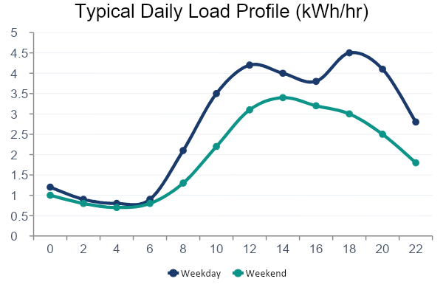
Exploratory Data Analysis
Key EDA Findings
Strong daily cycle (lag-24 ACF)
Weekly seasonality (lag-168 ACF)
Peak hours: 8–10AM & 6–8PM
Avg load: ~3.2 kWh/hr
Non-stationary: instance normalization required
No missing values (DST handled specially)
9 / 18

Slide 11
Architectures
LSTM
TCN
Transformer
PatchTST
Baseline Recurrent
Temporal Conv. Net
Vanilla Encoder-Decoder
Patch-based Transformer
2-layer stacked LSTM
Hidden: 128→64
Direct multi-step output
Dropout 0.2
5 TCN blocks
Dilations: 1,2,4,8,16
Kernel size = 3
Fastest training
4 encoder layers
8 attention heads
d_model = 256
Long-range attention
Patch size = 16
3 encoder layers · 8 heads
d_model = 128
Best accuracy ✓
Baseline
Speed
Global
Best
6 / 12
10 / 18

Slide 12
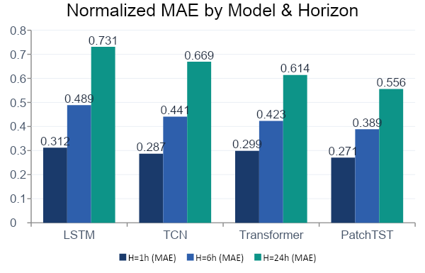
Preliminary Results
Key Takeaways
🥇 PatchTST leads all
horizons (H1, H6, H24)
📉 All models degrade
with longer horizons
⚡ TCN is 2× faster
than LSTM to train
🎯 Transformer models
degrade more slowly
11 / 18

Slide 13
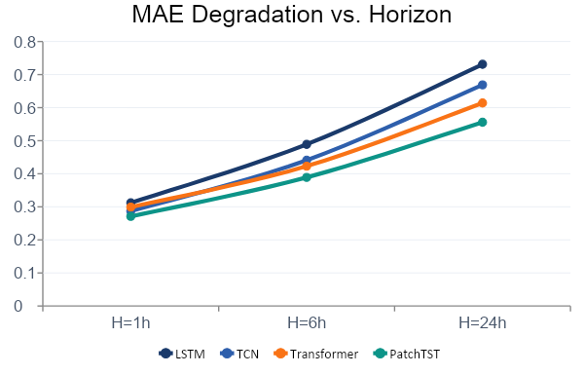
Accuracy Degradation by Forecast Horizon
Degradation H1→H24
(% MAE increase)
LSTM
+134.3%
TCN
+133.1%
Transformer
+105.4%
PatchTST
+105.2%
✓ Transformer models degrade 22% less than recurrent models
12 / 18

Slide 14
Multi-Criteria Model Comparison
Short-Horizon
Accuracy
Long-Horizon
Accuracy
Training
Speed
Scalability
370 clients
Probabilistic
Extension
Overall
LSTM
★★★☆☆
★★☆☆☆
★★☆☆☆
★★★☆☆
★★☆☆☆
★★☆☆☆
TCN
★★★★☆
★★★☆☆
★★★★★
★★★★☆
★★☆☆☆
★★★☆☆
Transformer
★★★★☆
★★★★☆
★★★★☆
★★★☆☆
★★★★★
★★★★☆
PatchTST
★★★★★
★★★★★
★★★★☆
★★★★☆
★★★★★
★★★★★
13 / 18

Slide 15
Selected Model: PatchTST
Best performing architecture — justified selection
Why PatchTST?
🥇
BEST
01
Best MAE/RMSE on all three forecast horizons (1h, 6h, 24h)
02
Lowest degradation: +105.2% H1→H24 vs +134.3% for LSTM
03
Patch tokenization reduces attention O(T²) → O(T²/P²) complexity
04
Natural backbone for LDT autoencoder (Feng et al., AAAI 2024)
05
Supports probabilistic extension via diffusion head in D3
14 / 18

Slide 16
Reference: Latent Diffusion Transformer (LDT)
Feng, Miao, Zhang & Zhao · AAAI 2024
Statistics-Aware Autoencoder
Diffusion-Based Conditional Generator
Compresses high-dimensional multivariate timestamps into a low-dimensional latent representation.
• Considers dynamic statistics
• Encoder-decoder symmetric architecture
• Enables scalability to 370+ clients
Generates probabilistic forecasts in latent space using a denoising diffusion process.
• Conditioned on historical context
• Produces calibrated forecast distributions
• State-of-the-art CRPS on UCI Electricity
15/ 18

Slide 17
Summary - Key Insights
DATA
MODELS
UCI dataset: zero missing values, 320 active clients, strong daily & weekly seasonality
All 4 architectures share same dataset, optimizer, and evaluation — fair comparison
DST handling critical: spring forward = zero-fill, fall back = 2× aggregated spike
PatchTST patch tokenization reduces attention complexity O(L²) → O((L/P)²)
Lookback window of 168h (1 week) justified by ACF peaks at lag-24 and lag-168
Direct multi-step output avoids autoregressive error accumulation at H=6h, H=24h
RESULTS
NEXT STEPS
PatchTST best across all 3 horizons: MAE 0.271 / 0.389 / 0.556
D2: Scale to 320 clients, add cyclical time features (hour_sin/cos, dow_sin/cos)
Transformer architectures degrade ~22% less than recurrent models H=1→H=24
D2: Systematic hyperparameter tuning with Optuna for all 4 architectures
TCN is the best accuracy/speed trade-off — 2× faster than LSTM with better metrics
D3: Implement LDT — PatchTST encoder → statistics-aware autoencoder → diffusion head

Slide 18
Challenges Encountered
Challenges
Encountered
1
DST Anomalies
Spring forward creates zero-filled 01:00–02:00 windows. Fall back generates 2× aggregated spikes. Both must be handled explicitly — not treated as errors.
2
Client Heterogeneity
Residential, commercial, and industrial profiles differ drastically. A single model must generalize across CV range 0.2–0.8+ without per-client fine-tuning.
3
Transformer Complexity
Full O(L²) attention over 168 timesteps is computationally expensive. PatchTST's patch mechanism is the practical solution — reducing to O((L/P)²).
4
Training Scale
Full 320-client training on CPU is prohibitive. GPU acceleration required for D2/D3. Demo uses N=20 clients for speed.
5
Non-stationarity
Mixed ADF/KPSS signals: mean-reverting within-year but trend over 4 years. Z-score normalization per client (fit on train only) addresses this.

Slide 19
Future Steps
D1
Current
D2
D3
Final
Baseline Models
Full-Scale Training
LDT Implementation
Full Benchmark
LSTM, TCN, Transformer, PatchTST
All 320 clients
Statistics-aware autoencoder
CRPS / WIS metrics
UCI dataset EDA & preprocessing
Hyperparameter tuning
Diffusion-based generator
Complete comparison
Metric framework established
PatchTST as primary model
Probabilistic intervals
Final conclusions
✓
16 / 18

Slide 20

Team
Ritika Rajeev Chatterjee
Akriti
Agarwal
Haasita Pinnepu

